Slide 1
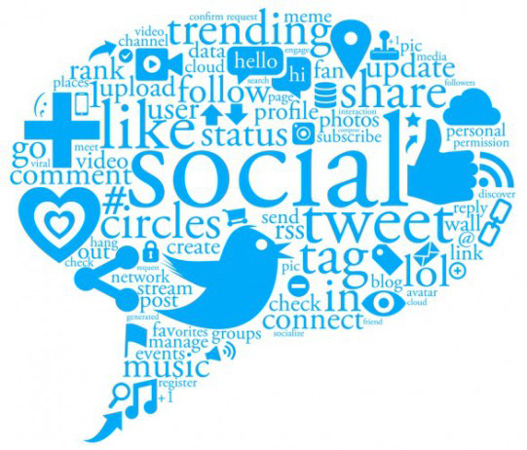
A HYBRID CLASSIFICATION ALGORITHM TO CLASSIFY ENGINEERING STUDENTS SENTIMENTS
Team Members:
Keshav Mittal
Keerthana Mohan

Slide 2
Background study of paper
The social networking sites have brought a new horizon for expressing views and opinions of individuals
They provide medium to students to share their sentiments including struggles and joy during the learning process
Such informal information has a great venue for decision making

Slide 3
Background study of paper
The large and growing scale of information needs automatic classification techniques
Sentiment analysis is one of the automated techniques to classify large data
The existing predictive sentiment analysis techniques are highly used to classify reviews on E-commerce sites to provide business intelligence

Slide 4

Background study of paper
However, they are not much useful to draw decisions in education system since they classify the sentiments into merely three pre-set categories: positive, negative and neutral
Moreover, classifying the students’ sentiments into positive or negative category does not provide deeper insight into their problems and perks

Slide 5
Proposed Solution
This paper suggests hybrid classification algorithm to classify sentiments
Unlike traditional predictive sentiment analysis techniques, the proposed algorithm makes sentiment analysis process descriptive

Slide 6
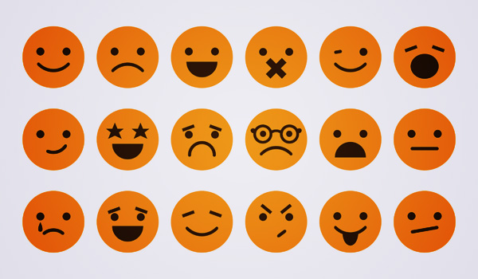
Proposed Solution
It classifies engineering students perks in addition to problems into several categories
Helps future students and education system in decision making
Idea: classify the emotions in more than 3 categories like angry, funny, confused apart from the traditional categories like positive, negative and neutral.

Slide 7
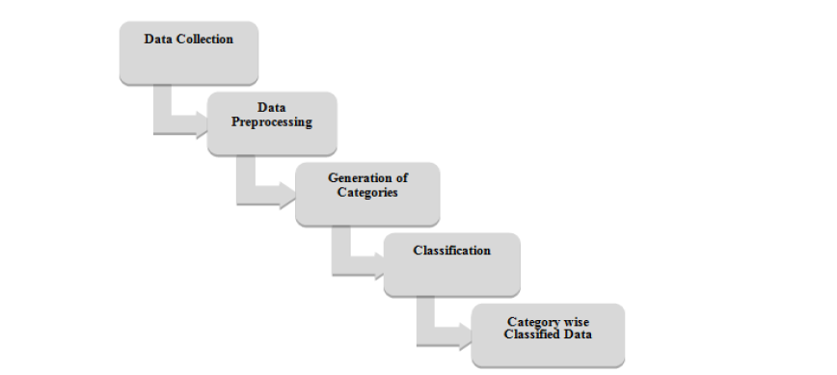
Hybrid Algorithm Processing Steps
Image source : [1]

Slide 8
Data Mining Steps
Data Collection
Data Pre-processing
Generation of Categories
Data Mining Methods (Suggested)
Data Mining Method(Implemented)

Slide 9
Data Source
Selection of data source to conduct the back stage study to classify students’ problems and perks plays significant role
Our source : Twitter
Data collection : Twitter API to download data from Twitter
Programmatic download of data from Twitter

Slide 10
Data Pre-processing
Following will be removed:
Hash-tags #
Stop words
Emoticons
Account Ids @
Re-tweets
Uniform casing
Quotations, punctuations etc.

Slide 11
Generation of Categories
Manually hand classified tweets based on different categories like positive, negative, neutral, funny, angry etc.
The above classified tweets will be used to train the classifier.

Slide 12
Data Mining(Suggested Methods)
Two techniques to identify sentiment :
Knowledge based method
Machine learning methods
Approaches:
Naïve Bayes approach
Maximum Entropy
Support Vector Machines

Slide 13
Data Mining Method(Implemented)
Technique used:
Machine learning methods
Approach Implementing:
Support Vector Machines

Slide 14
Support Vector Machine(SVM)
Support vector machines are supervised learning models with associated learning algorithms that analyze data used for classification and regression analysis
SVM provides higher theoretical accuracy in terms of correctly classifying the input data into valid categories

Slide 15
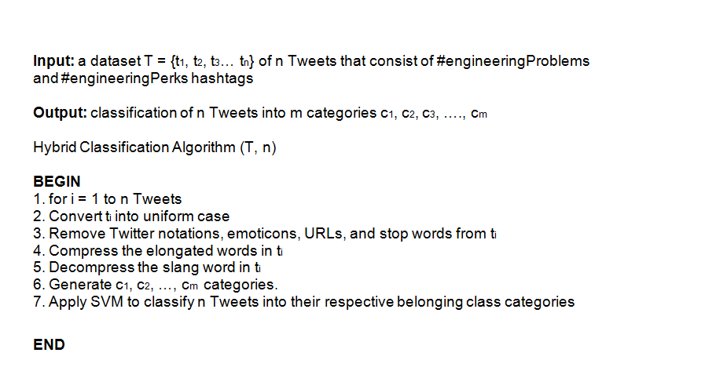
SVM(Algorithm)

Slide 16
Analytical Benefit
The categories shed insight into students’ actual existing problems and perks deeply than merely identifying positive or negative emotions
Moreover, they guide future students in determining their educational field
They are also useful in improving the quality of education system.

Slide 17
References
[1] Mitali Desai and Mayuri A. Mehta, "A HYBRID CLASSIFICATION ALGORITHM TO CLASSIFY ENGINEERING STUDENTS’ PROBLEMS AND PERKS", International Journal of Data Mining & Knowledge Management Process (IJDKP) Vol.6, No.2, March 2016
[2] I. King, J. Li and K. T. Chan, “A Brief Survey of Computational Approaches in Social Computing”, In Proc. of International Joint Conference on Neural Network, 2009, pp. 2699-2706.
[3] S. R. Barahate and V. M. Shelake, “A Survey and Future Vision of Data mining in Educational Field”, in Proc. 2nd Int. Conf. on Advanced Computing & Communication Technology, 2012, pp. 96-100.
[4] M. Dredze , “How Social Media Will Change Public Health”, IEEE Intelligent Systems, 2012, pp. 1541-1672.s

Slide 18


